Slide 1
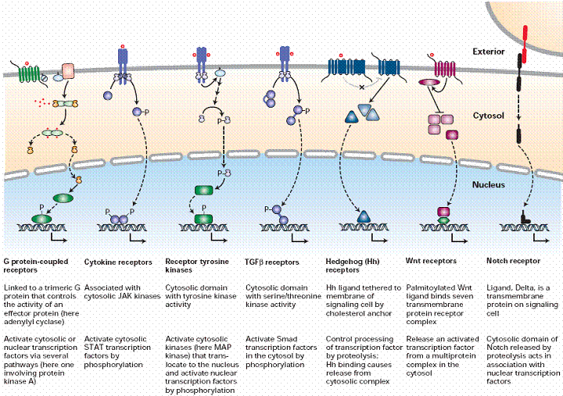

Slide 2
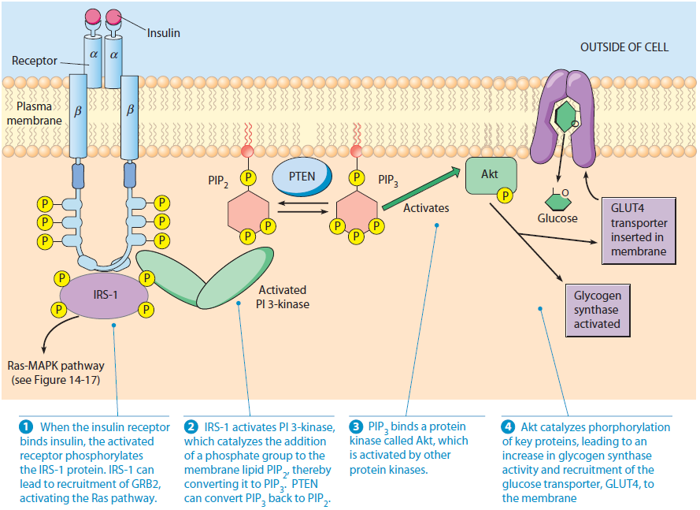
The Insulin Signaling Pathway. The insulin signaling pathway influences glucose
homeostasis by regulating multiple signaling pathways. The insulin receptor is a multisubunit receptor tyrosine kinase. When it binds insulin, recruitment and activation of the IRS-1 protein initiates signal transduction, leading to glucose import, stimulation of glycogen synthesis, and regulation of gene expression.

Slide 3
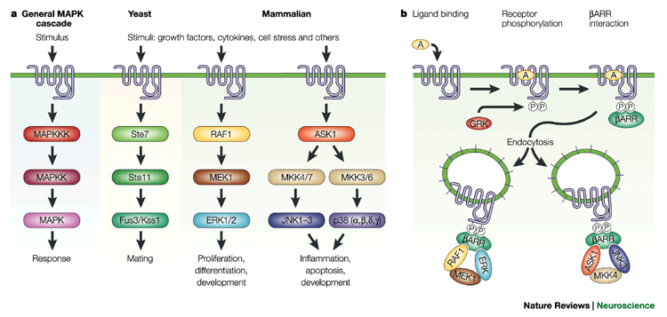
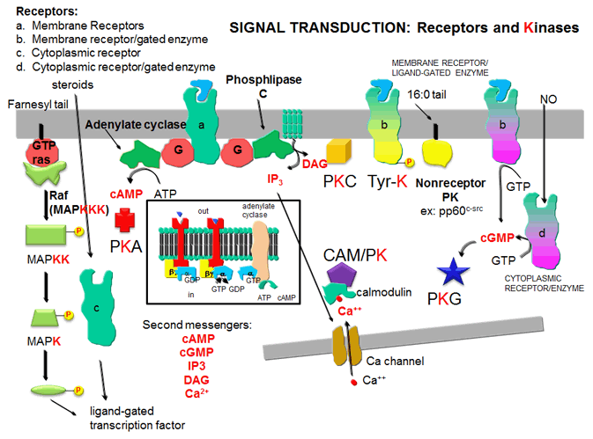

Slide 4
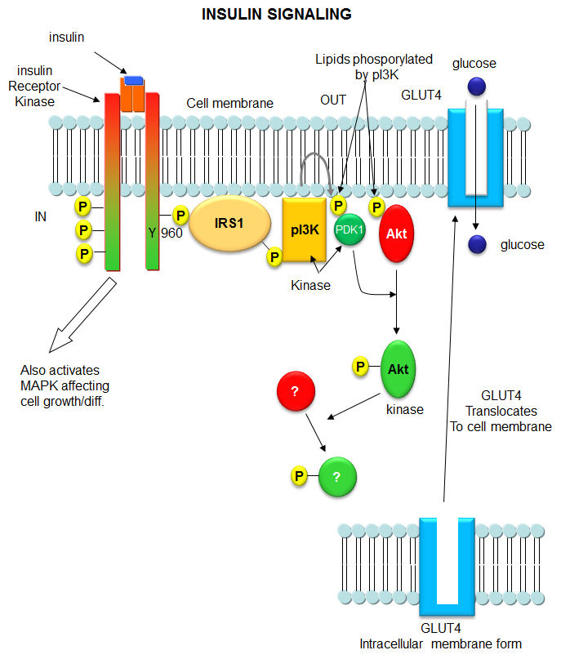
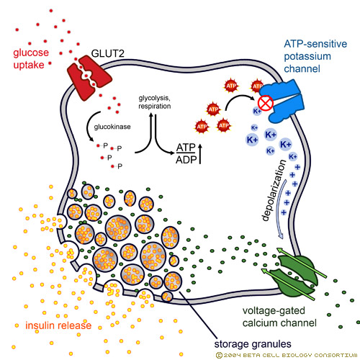

Slide 5
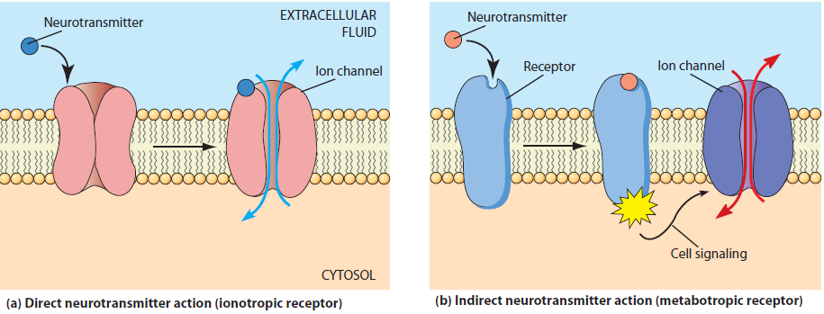
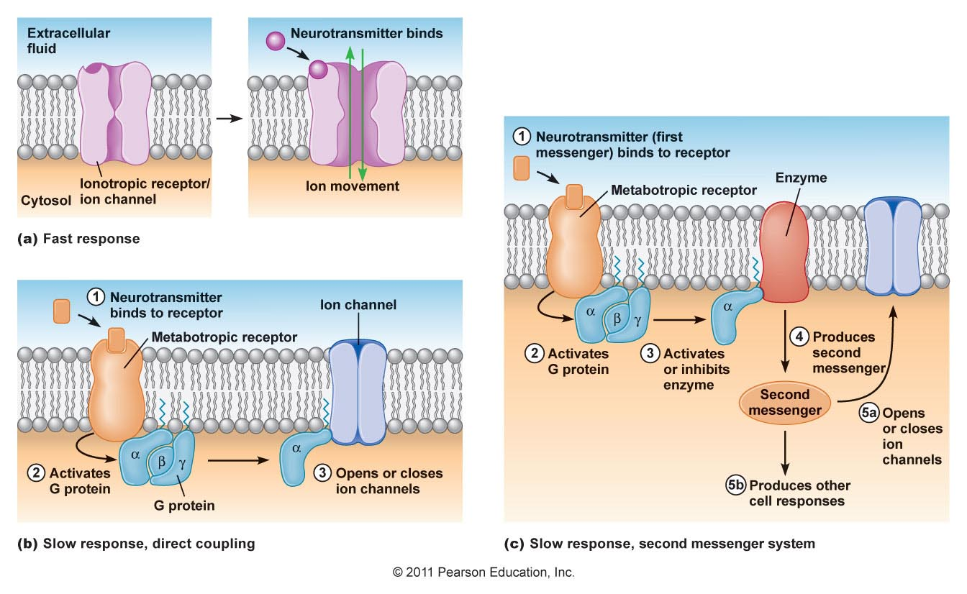
Synaptic Transmission

Slide 6
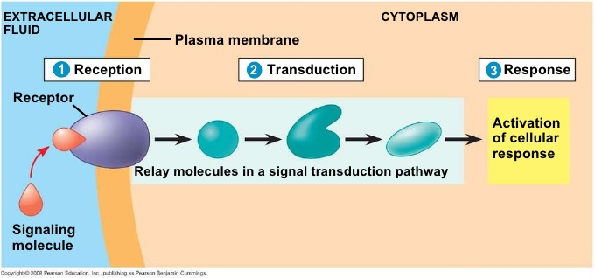
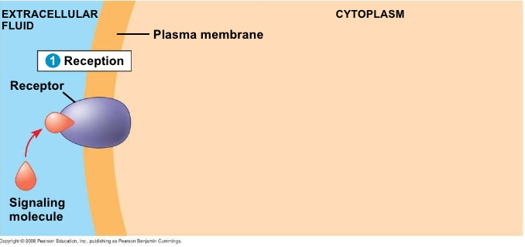
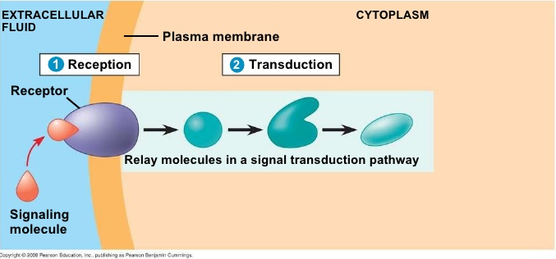
Sutherland's 3 Stages of Signalling
Reception
Transduction
Response

Slide 7
Cells Pumping Ions
The membrane proteins of cells are constantly utilizing ATP (energy) to pump ions in or out of the cell: normally these ions are K⁺ and Na⁺
The concentration of these ions is different on both sides of the membrane
Typically the concentration of Na⁺ ions is higher on the outside of cell membrane of a neuron than on inside: [Na⁺]_{out} > [Na⁺]_{in}
For K⁺: [K⁺]_{out} < [K⁺]_{in}

Slide 8
Membrane Potential
Because [Na⁺] on outside than inside, it would want to rush into the cell if a hole (or pore) were opened in the membrane, and K⁺ would want to rush out. This follows laws of thermodynamics, that molecules move to distribute themselves
The way the cell pumps ions around, it creates a membrane potential (meaning voltage across the membrane) because there is a difference in the amount of positive and negative ions across the membrane. From physics, a separation of charges creates a voltage

Slide 9
Depolarization
These differences in ion concentrations particularly describe the neuron
There are receptors in neuron dendrites that when bound to the neurotransmitter acetylcholine, they open a pore that specifically allows Na⁺ to pass through
When that happens, Na⁺ rushes from the outside to the inside, to equalize its concentration across the membrane
But in the process, the amount of total positive charge (of all ions) increases in the inside the cell, causing the inside to be more positive than the outside
This flip in charge across the membrane is called depolarization, and it can have an effect on membrane proteins that are sensitive to voltage and polarity changes

Slide 10
Repolarization
One effect on these changes in voltages or in polarity is that the acetylcholine-bound receptor open a Na⁺ channel can be closed to stop Na+ from entering
Another effect is that another membrane protein that is a K+ channel protein can be opened, and now K+ rushes from the inside to the outside of the cell
This can cause the membrane voltage to change, and indeed the effect is that the positive ions are now more on the outside than in, and the polarity switches back. This is called repolarization
This occurs to make the neuron sensitive again to another stimulus

